Slide 1
Secure Content Management Foundations Overview
Notes:
Welcome to the Secure Content Management Overview

Slide 2

Agenda
Trends
Customer Challenges
Solution Capabilities
Value to Change
Customer Success
Competition
Summary
Knowledge Check
Notes:
In this session we will cover the following:

Slide 3
Trends

Slide 4
Today’s Information Reality
Explosion
of data
Data
everywhere
Increased litigation
Escalating regulations
Data doubling every 12-18 months
New, unstructured data types to manage
Mobile, virtual, cloud joins physical
Distributed across organization
67% of users have three or more computing platforms
More litigation than ever before
Increasingly complex cases
Litigation increasingly involving ESI
Increasing volume and complexity of regulations
Growth in regulatory investigations
Tougher sanctions
it is getting more difficult for customers to manually govern their data
Notes:
Let’s think about today’s information reality for customers:
Data is growing within the organization, it is doubling every 12-18 months. In addition there are new unstructured data types to manage
This data is everywhere. No longer is information stored in a central data center, this information can be on physical, mobile, cloud or endpoint devices so knowing where you data is has become a challenge
There are more litigations than ever before, the cases are becoming more complex and increasingly involves Electronically Stored Information or ESI which organizations have to find and present.
Regulations are also increasing and becoming more complicated. This means organizations have more and more rules to adhere to and need to prove they are compliant via audits and regulator checks. Failure to do so will now result in tougher sanctions.
In summary it is getting more difficult for customer to manually govern their data

Slide 5

Information Governance is also critical to manage risk
41%
20%
45%
22%
of organizations
describe their email
as “chaotic”
of organizations say
bad IG practices
is the most likely
cause of data loss
of organizations say
a lack of IG leaves
them open to
litigation risks
reported negative
financial impact
from cases involving
electronic records
Notes:
And Governing Data is key to managing risk. Here are some survey results from the IDC.
41% of organizations describe their email as chaotic
20% of organizations say bad IG practices is the most likely cause of data loss
45% of organizations says lack of IG leaves them open to litigation risks
22% reported a negative financial impact from cases involving electronic records

Slide 6
Customer Challenges

Slide 7
Customer Concerns
Governance, Compliance, Security and Costs
Director of Information Services/Records
Chief Compliance Officer
Chief Legal Officer
Chief Information Governance Officer
Pain Points
Siloed and disparate data repositories make it difficult to find, classify or present information
Dark data may include information that needs to comply with policies / regulations
Manual processes are inefficient and results in inconsistencies
Chief Information Officer
Chief Information Security Officer
Pain Points
Data growth outpacing budget – required to do more with less
Disparate data repositories results in Dark Data across the organization which increases risk
Application Manager
Line of Business Manager
Pain Points
Costs of maintaining multiple applications are rising as budgets are reducing
Application performance issues due to database size
Unable to respond to information requests in a timely manner
Apply and enforce policies to manage both structured and unstructured information through its lifecycle to improve compliance state. Reduce the cost and risk associated with managing legacy and rarely used databases and applications.
Notes:
Organizations are looking to apply and enforce policies to both structured and unstructured information throughout it’s lifecycle to improve compliance state. In addition they are looking to reduce the cost and risk associated with managing legacy and rarely used databases and applications.
There are various personas within an organization who are looking to govern data more effectively. These can be grouped into three categories, the first being:
Director of Information Services/Records / Chief Compliance Officer / Chief Legal Officer / Chief Information Governance Officer – the challenges they face include not being able to find, classify or present information. Sensitive Data that may be sitting in repositories that no one is aware of and therefore isn’t being governed. Inefficient and inconsistent policy application as there are too many manual processes.
Chief Information Officer / Chief Information Security Officer – the challenges they face include, data growth outpacing budget, they are required to store and manage all of this information with less. Data that may be sitting in repositories that no one is aware of is also a concern as this increases the organization’s risk exposure
Finally we have the Application Manager and Line of business managers are concerned about costs of maintaining multiple applications, the performance of applications and not being able to respond to information requests in a timely manner.
All of these personas are looking for a solution to better govern their data but all have different drivers. Generally speaking when positioning the SCM suite the Personas on the left are the key buyers and individual on the left are key influencers. All three will benefit from the solution in their respective areas but Legal and Compliance are the budget holders for us.

Slide 8
Solution Capabilities
Notes:
So let’s take a look at the SCM solution capabilities

Slide 9
Secure Content Management Suite
Secure Content Management
ControlPoint
Content Manager
Structured Data Manager
Voltage
File & content analysis
Policy-Based Governance
Data archiving & application retirement
Data masking
Identification of personal data/
PII, PCI, PHI
ROT Analysis
Enterprise policy application
Manage-in-place
Security & access
Redaction
Retention
Disposition
Archiving
Reporting
Identification of sensitive data PII, PCI, PHI
Redaction (Voltage integration)
Encryption/ Decryption
Notes:
The SCM suite consists of four solutions, Content Manager, Control Point, Structured Data Manager and Voltage. Each of these solutions can be sold individually but when combined, all four can be part of a complete end to end information lifecycle management solution.
In this session we will provide an overview of Content Manager, Control Point, Structured Data Manager – as they can be sold individually look out for more in depth enablement modules for each solution.
As voltage is part of the security portfolio, please look out for a separate modules which cover this solution in more detail.

Slide 10
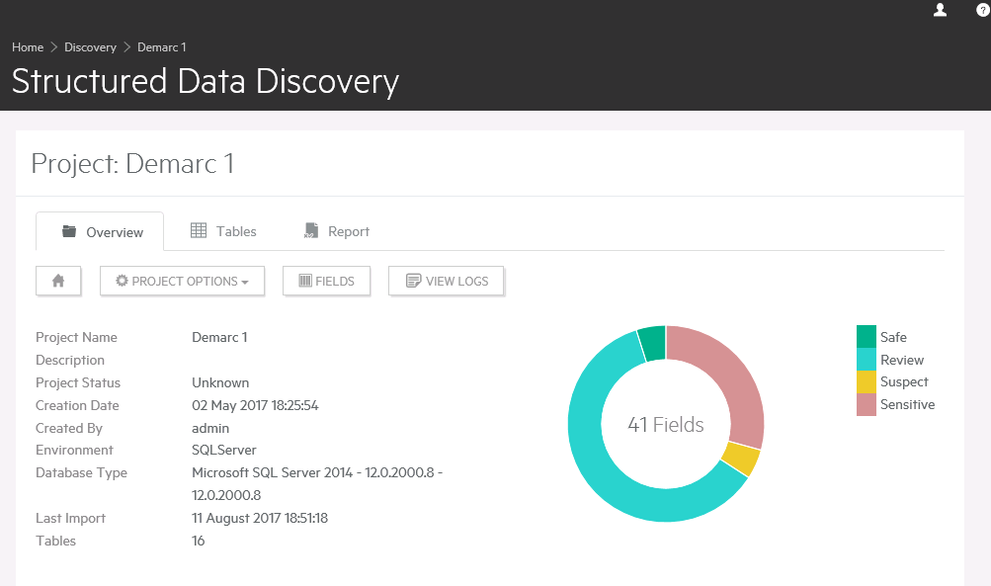
Structured Data Manager
Structured Data Manager provides automated information lifecycle management by relocating data from production systems and legacy databases while preserving data integrity and access.
Use Cases
Reduce licensing & maintenance costs by retiring legacy applications
Improve backup / recovery times by better managing your data footprint
Improve productivity by accessing data from multiple legacy systems on one platform
Reduce risk by consolidating data from multiple applications for consistent policy application
Analyze customer data more easily for potential revenue generation
Accelerate transformation objectives e.g. migrate to cloud
Retired 70 business applications, 23+ billion rows archived, 72TB+ (compressed) | Query time reduced by 89% Storage reduced by 48% | Full backup window reduced by 37%
Notes:
The first solution is Structured Data Manager, this helps customers relocate data from business applications whilst preserving data integrity and access. In essence, the business can search for information that was once held within multiple business applications whilst reducing the associated cost and risk of having multiple systems.
Some example use cases include:
Reduce licensing & maintenance costs by retiring legacy applications
Improve backup / recovery times by better managing your data footprint
Improve productivity by accessing data from multiple legacy systems on one platform
Reduce risk by consolidating data from multiple applications for consistent policy application
Analyse customer data more easily for potential revenue generation
Accelerate transformation objectives e.g. migrate to cloud
At the bottom of the slide you will see some examples of what a customer was able to achieve using SDM, this includes retiring 70 applications, archiving over 23 billion rows of data, which reduced their storage by 48%, improved query times by 89% and reduced the time it took to complete a full back up by 37%

Slide 11
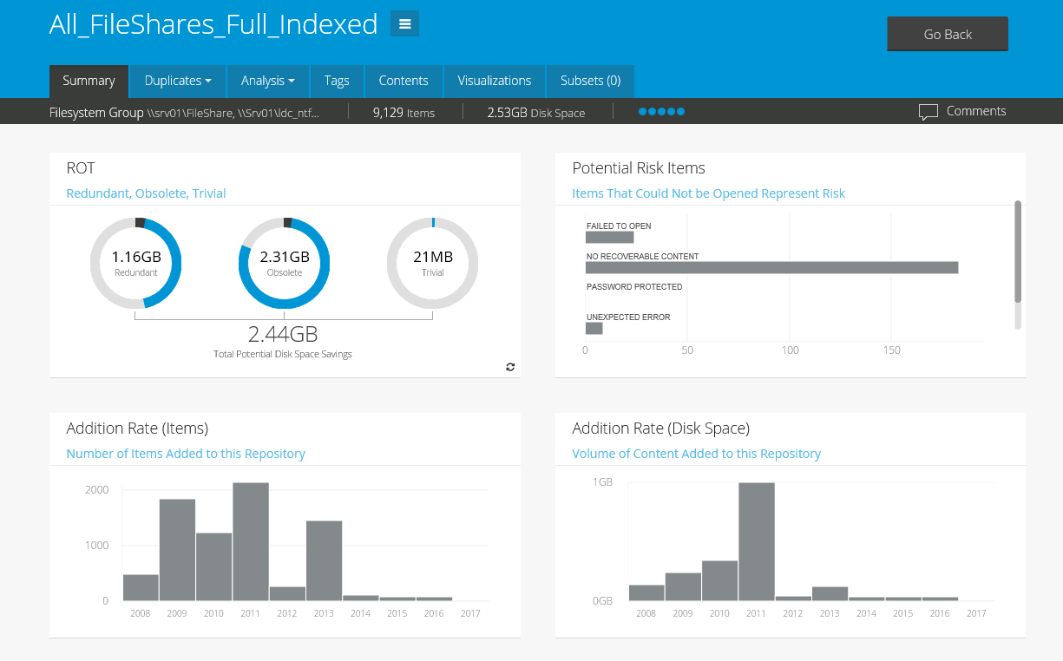
ControlPoint
ControlPoint is file analysis software that helps organizations achieve their information governance objectives by identifying, analyzing, connecting and controlling information contained in siloed repositories across the enterprise.
Use Cases
Reduce risk by identifying dark data
Improve information search times by knowing what information is held across data silos
Analyze and identify sensitive information
Automatically apply policy to sensitive information
Save cost by identifying ROT data and migrate this to cheaper storage or dispose of it
Reduce backup workloads by reducing your information footprint
40% improvement in analysis, review & reporting time | 60% reduction in tier 1 storage space | 40% cost reduction for storage operations & legal exposure
Notes:
ControlPoint is a solution that helps customers identify, analyze and control their unstructured data. ContolPoint can be directed toward data repositories and can analyze the files and tell you what information is being held there. In addition to reviewing the metadata ControlPoint also can analyze and understand the information within the file itself.
Some example use cases include:
Reduce risk by identifying dark data
Improve information search times by knowing what information is held across data silos
Analyse and identify sensitive information
Automatically apply policy to sensitive information
Save cost by identifying Redundant Obsolete and Trivial data and migrate this to cheaper storage or dispose of it
Reduce backup workloads by reducing your information footprint
Again at the bottom you will see some examples of what customers were able to achive with ControlPoint – these include a 40% improvement in information analysis, review and reporting times, a 60% reduction in tier 1 storage space and a 40% cost reduction in storage operations and legal exposure

Slide 12
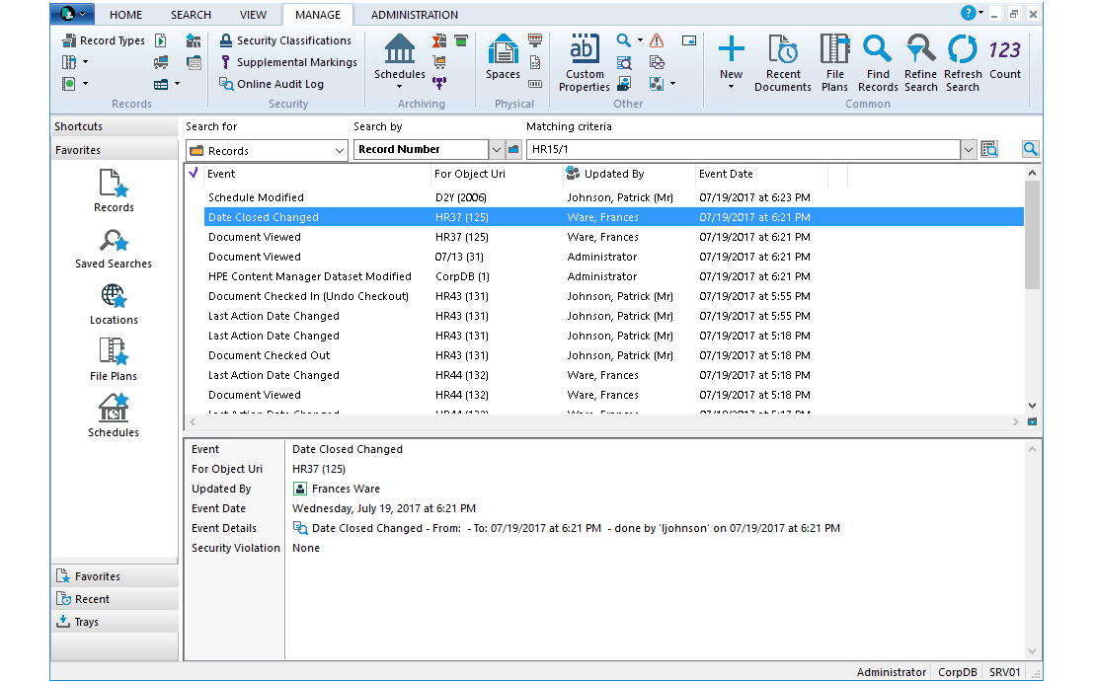
Content Manager
Content Manager is a governance-based enterprise content management system designed to help manage your business content from creation to disposal according to policy.
Use Cases
Apply policies to your information at enterprise level
Automatically classify business information at the point of creation
Manage access to information with document check in/out and versioning
Save costs by migrating content for long term retention to cheaper storage
Dispose of information that you no longer are required to keep whilst retaining the necessary audit trails
Improve productivity with simple contextual search
87% of customers agree Content Manager is considered a vital business application within our organization, it helps us capture, manage, access and secure business documents and records from creation to disposal. - TechValidate
Notes:
Content Manager is an enterprise content manage system. Through a single solution, customers are able to apply, manage and enforce policies to all of their enterprise information. The policies can be based on internal requirements or by locals laws or regulations such as HIPPA, GDPR and so on.
Some example use cases include:
Apply policies to your information at enterprise level
Automatically classify business information at the point of creation
Manage access to information with document check in/out and versioning
Save costs by migrating content for long term retention to cheaper storage
Dispose of information that you no longer are required to keep whilst retaining the necessary audit trails
Improve productivity with simple contextual search
At the bottom you will see a survey result from Tech Validate. Customers were asked if Content Manager is considered a vital business application within their organization and 87% of them agreed. The participants of this survey included, Governments, Fortune 500 companies, Small and Large Enterprises and educational, cultural and non-profit organizations.

Slide 13
SCM – Solution Architecture
Redundant, Obsolete & Trivial (ROT)
Apply policy to manage in place
Manage in-place
Unstructured Data Repositories
File Analysis
Identify
Analyze
Categorize
Curate
Connect
Declare content and records
Auto classify
Policy
Security
Redaction
Encryption
Authorized access
Reporting
Audit logs
Enterprise Content Management
Lifecycle Management
Intelligent Archiving
Identify PII, PCI, PHI
Defensibly Dispose
Structured Data Repositories
Structured Data Management
App Retirement
Data extraction
Data Masking
Extract
Valid Data
Legacy Data and ROT
Notes:
As mentioned earlier the Secure Content Management Solutions can be sold individually or together as part of the SCM suite. Each solution has a number of use cases which may or may not be important to your customer at that time. It is important to understand there are a number of ways in which a customer may be able to use the SCM suite. In this slide we will go through one way in which a customer can adopt the suite.
A customer may be initially looking to reduce the risk and cost in maintaining multiple business applications. They may need to keep some of the data for reporting and want to delete the information they no longer require. Structured Data Manager can help them retire legacy applications and extract the data they need to keep and dispose of the data they on longer require.
The customer may then look to do the same with their unstructured data, remove anything they longer need. ControlPoint can analyze the unstructured data repositories and identify what can be disposed of. The remaining information may remain where it is.
Due to regulations the customer may need to better manage certain information. For example with GDPR organizations need to manage all information relating to an EU citizen. At this stage the customer has SDM and ControlPoint and can identify any information that is applicable to this new requirement. SDM and ControlPoint can find this information which needs to be monitored. This data can be managed in accordance with the rules with Content Manager. When there is no obligation to keep the data the data can be disposed of but all of the audit trails still remain.
Again it is important to remember this is just one example and this may vary depending on your customer, their requirements and what solutions they already have in place. This example is just to highlight the end-to-end enterprise lifecycle management capability of the SCM suite.

Slide 14
SCM – A structured approach to governance
Classify
Monitor & Act
Apply Governance Policies
Focus on only in-scope information
Unstructured Data Repositories
In-Scope Data
Manage Lifecycle
Apply analytics to high-value info.
Data for Disposition
Prepare for Litigation
Structured Data Repositories
Optimize Backup & Recovery
Build customer confidence
Data Not In Scope
Encrypt & Protect
Protect data in use, in transit, and at rest
Monitor Breaches
Notes:
With our SCM suite we have a structured approach to information governance which can be applied to help facilitate compliance for any regulation or requirement. Whether it is GDPR which we mentioned in the previous slide, or HIPPA or PCI information it doesn’t matter as with SCM we have the same structured approach to governing data.
The SCM suite enables customer to review their unstructured and structured data repositories with SDM and CP to identify what data falls within scope of the new requirement and manage that data in accordance with the policies with Content Manager.

Slide 15
Business Value

Slide 16
How our customers are leveraging SCM
Core use cases for managing risk and cost, plus driving efficiency and value
Regulatory Compliance
Information Governance
Privacy
EU GDPR (May 2018)
California Privacy Legislation
Massachusetts Privacy Act
Financial Services Regulation
Banking Secrecy Act/Anti-Money Laundering
Dodd-Frank
FINRA 17-18 (social media and digital communications)
MIFID II
Corporate Transparency
FDA Title 21 Food, Drug, Devices, Cosmetics, Tobacco etc.
CFPB Truth in Lending, Consumer Leasing, Home Mortgage Disclosure
Security
New York Department of Financial Services Cybersecurity Requirements and Data Privacy Obligations (Mar 2017)
Data Breach and Notification Obligations (Cyber 2017)
Public Sector
Capstone
Freedom of Information Act (FOIA)
Risk Mitigation
Personal data assessment (GDPR Starter Kit)
Global Policy Management
Litigation readiness
Records Management
Social media governance
Breach Response & Reporting
Automated Data Encryption
Cost Savings
Defensible disposition
Application retirement
Policy-based governance
Operational Efficiency
Workday migration (from PeopleSoft or SAP)
Application upgrade (e.g., SAP to SAP HANA)
SharePoint compliance
Auto records declaration
Intelligent cloud migration
Value Creation
Collaboration
Best practices identification
Data mining
Notes:
Here are some examples of how customers are leveraging SCM to manage risk, reduce cost and drive efficiency and value.
Please pause this video to review the use cases and resume when you are ready to proceed.

Slide 17
Customer Success

Slide 18

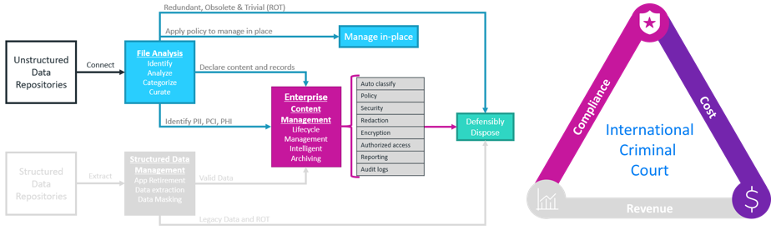



International Criminal Court
Industry: Legal
Buyer and Challenge
Requirements
Solution
Head of Records and Archives Management
Gain understanding of it’s information architecture
Ensure sensitive information is stored appropriately
Identify records within their repositories
Reduce the number of duplicate records
Manage documents based on policies
ControlPoint: Identify duplicate records and sensitive information across their information architecture
Content Manager: migrate sensitive information to Content Manager to ensure it is managed according to policy
Results: 30% of data consisted of duplicate records and tagged their records as working documents, legacy documents and trivial documents for better management
Notes:
The International Criminal Court is an intergovernmental organization and international tribunal that is based in the Netherlands. The ICC has the jurisdiction to prosecute individuals for the international crimes of genocide, crimes against humanity, and war crimes.
The information they have can be of a extremely sensitive nature and they were looking for a solution to gain an understanding of their information architecture and ensure sensitive information is stored appropriately.
They were looking for a solution to identify records within their repositories and reduce the number of duplicates they had. These documents also had to be managed based on policies.
The ICC used control point to identify sensitive information and duplicates across their information architecture. The sensitive information was then migrated to content manager to ensure it was managed according to policy.
Here is an example of the solution architecture that was adopted.
Using the SCM solution, the ICC found that 30% of the data analyzed consisted of duplicate records. The remaining records were better classified which improved the overall management of information.

Slide 19

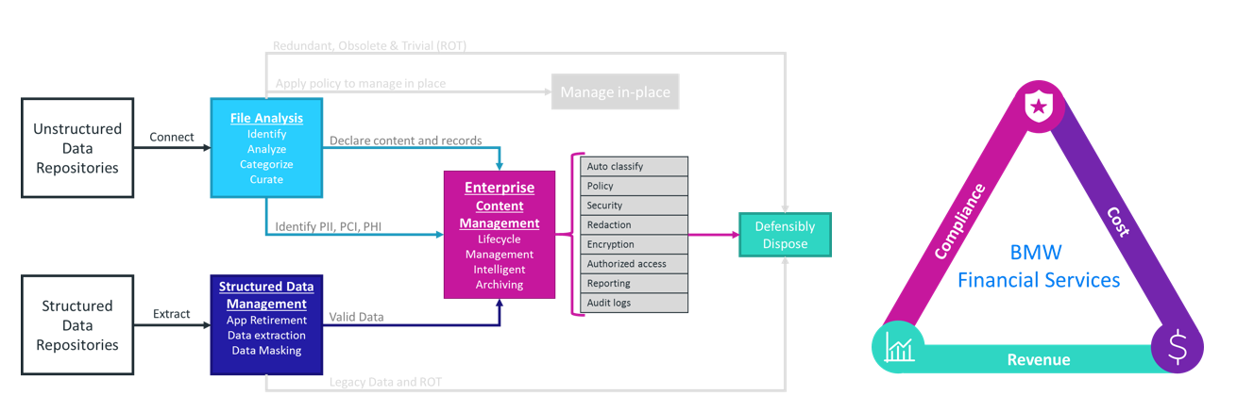
BMW Financial Services
Industry: Financial Services
Buyer and Challenge
Requirements
Solution
Application Manager & Operational Risk Manager
Preserve information about car loan decisions to help make deals in the future
Needed this information to comply with US regulations including those related to predatory lending
Capture and apply retention policies to information stored in databases
Capture and apply retention policies to unstructured data
Structured Data Manager: identify, classify and archive unstructured data
ControlPoint: identify, classify and archive unstructured data
Content Manager: secures and applies retention policies to the information
Results: preserve valuable records which could help secure deals in the future, address regulatory compliance, remove the need to purchase additional products to manage unstructured data. The solution has attracted attention within the wider BMW Group
Notes:
The US arm of BMW Fincial Services were looking for a solution that would preserve information about car load decisions to help make deals in the future whilst being able to ensure this information complys with US regulations, including those related to predatory lending.
They were looking for a solution that could capture both structured and structured data and apply retention policies to this information.
BMW Financial services used the SCM to identify, classify and archive unstructured data with Structred Data Manager, identify, classify and archive unstructured data with Control Point and were able to secure and apply retention policies to the information with content manager
Here is an example of the solution architecture that was adopted.
Using the SCM solution, BMW financial services were able to address their compliance requirements, use the records to help secure more deals in the future and remove the need to purchase additional solutions to manage their unstructured data. The use of the SCM suite has also attracted the attention within the wider BMW Group.

Slide 20
Competition

Slide 21
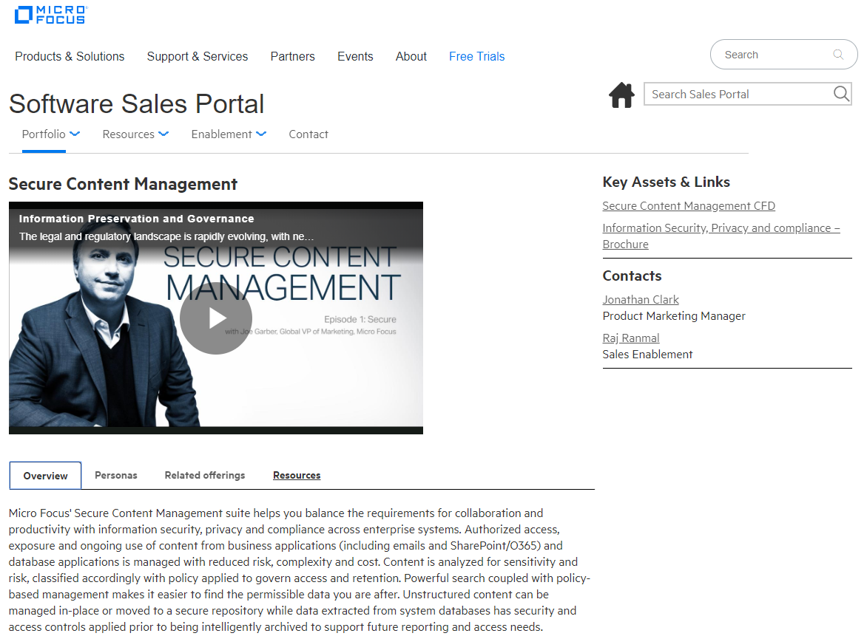
Secure Content Management
End-to-End Information Lifecycle Management
Governance/Policy Management
File Analysis
Structured Data Management
  Micro Focus Secure Content Management
Notes:
There are a number of vendors that will compete with each of our SCM solutions. You can find the most up to date information on the Software Sales Portal.
From a SCM Standpoint, here are some of the our areas of strength:
We are one of the few vendors that can offer a complete end to end solution. This coupled with the wider MF Portfolio is what we should be talking about to our customers when positioning our solution.
Additionally the SCM portfolio is designed to work with existing solutions that customer may be using rather than requiring them to rip and replace what they have already invested in.
Some vendors require customers to move their data to a central repository before being able to help govern this information. As a customer, having to find and migrate the data before you are able to manage it can be a huge task in itself which brings additional cost and risk. With the SCM portfolio this is not a requirement, customers can manage their data in place.

Slide 22
Summary
Notes:
To summarise

Slide 23
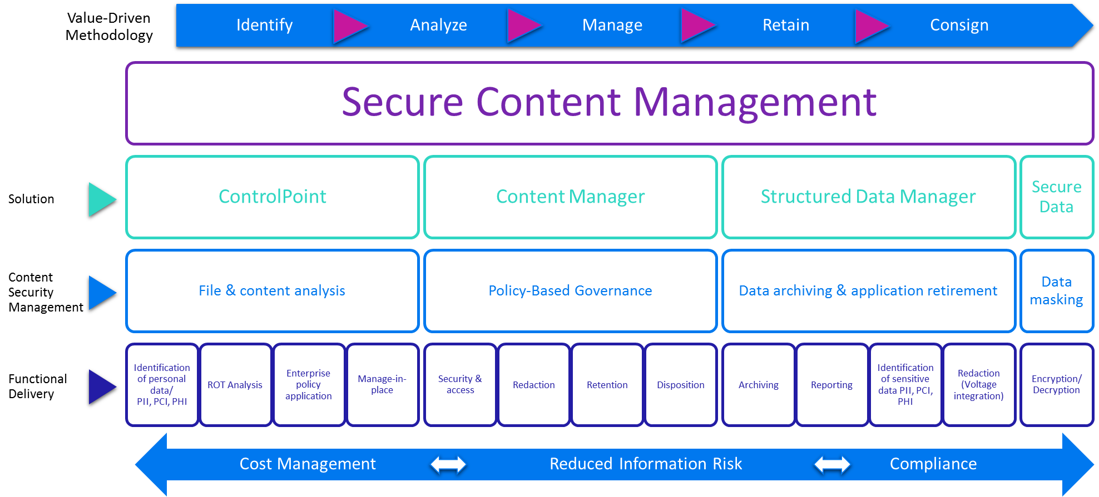
Secure Content Management
Capture, manage and secure enterprise information in business context
Secure Content Management suite helps you balance the requirements for collaboration and productivity with information security, privacy and compliance across enterprise systems.
Notes:
Secure Content Management suite helps customers balance the requirements for collaboration and productivity with information security, privacy and compliance.
It helps customers identify, analyze and manage their business information from creation to disposal and helps organizations manage costs and risk whilst helping ensure compliance.

Slide 24
Knowledge Check
Notes:
Now let’s complete a quick knowledge check

Slide 25

Thank you

